Slide 1

Introduction to DevOps

Slide 2



Course : Mastering DevOps
Lecture On : Introduction to DevOps
Instructor: Dipesh Garg

Slide 3



Minimum Viable Product
Introduction to DevOps
DevOps Road Map

Slide 4
MODULE OVERVIEW: INTRODUCTION TO DEVOPS
Building a minimum viable product
Common deployment problems
Understanding DevOps
DevOps principles and best practices
Road map to a successful DevOps career
DevOps: Roles and responsibilities

Slide 5


Minimum Viable Product
Introduction to DevOps
DevOps Road Map

Slide 6
SESSION OVERVIEW:
MINIMUM VIABLE PRODUCT
Concept of Minimum Viable Product
Advantages of an MVP
Software development life cycle (SDLC)
Review the waterfall methodology
Review Agile methodologies
Understand deployment issues

Slide 7
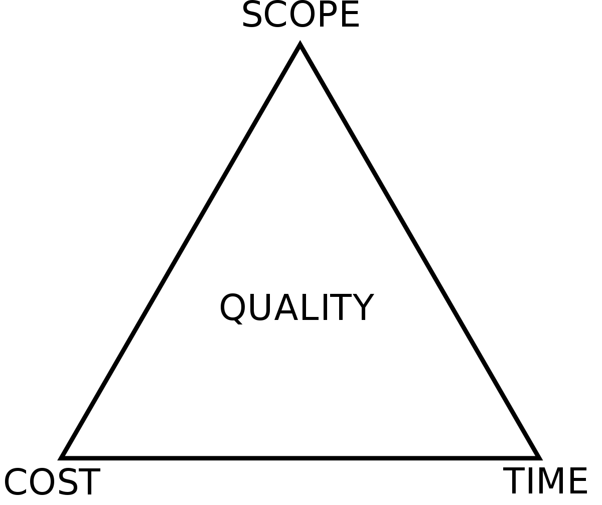
PRODUCT DEVELOPMENT

Slide 8
PRODUCT DEVELOPMENT
Cost
Budgeted amount available for a project
Time
Time available to complete a project
Scope
Features that make the product

Slide 9
SOCIAL MEDIA FEATURES
Create a profile
Upload images
Add a “Like” button
Create an “Inbox”
Upload videos
Add a “Video chat” feature

Slide 10
CUSTOMER FEEDBACK
Create a profile
Upload images
Add a “Like” button
Create an “Inbox”
Upload videos
Add a “Video chat” feature

Slide 11
USER FEEDBACK
1
2
3
4
UX/UI
Video Upload
Chat Box
Share
User-suggested UI changes
Incorporate these changes in every feature
Users do not have enough bandwidth for video uploads
Time and resources were wasted on this feature
Less time is spent over the internet; hence, people prefer using their inbox over the chatbox
It might be useful the in future, but we can ignore this feature in the present scenario
Users want the option for sharing images that we discarded during the research phase

Slide 12
ANOTHER WAY TO LAUNCH A PRODUCT
Second Iteration
Fourth Iteration
Initial Launch
Third Iteration
Second Month
Profile
Third Month
Profile
Images
Sixth Month
Profile
Images
Like button
Inbox
Tenth Month
Profile
Images
Like button
Share
Inbox
Video chat
Feedback:
User-suggested UI changes
Feedback:
User wants a “Like” button for images
Feedback:
User wants to share images

Slide 13
MVP: AIM
01
Enter the market quickly
02
Gather feedback for the primary product and include it in future iterations
03
Minimise wastage of resources on unnecessary features at the initial stage

Slide 14
MINIMUM VIABLE PRODUCT
“
The minimum viable product is that version of a new product which allows a team to collect the maximum amount of validated learning about customers with the least effort
“
- By Eric Ries, The lean Startup Framework

Slide 15
UNDERSTAND MVP BETTER
MVP is similar to an experiment that will help you assess whether people will like your product
It saves you from wasting your time and money on something that people will not like
An MVP is a version of a product that has only those features necessary to implement the core idea
MVP
An MVP is a ready-to-launch version of a product that is not rolled back but iterated with new features based on user feedback
E.g.: App launched with the core functionality & is available in the market
PROOF OF CONCEPT
Evidence, typically derived from an experiment or pilot project, which demonstrates that a design concept, business proposal, etc. are feasible
E.g.: Piece of code created to test the technology in an R&D lab
PROTOTYPE
A skeleton version made available to stakeholders for internal review on the appearance and feel of the application
E.g.: App skeleton created for reviewing UI/UX

Slide 16
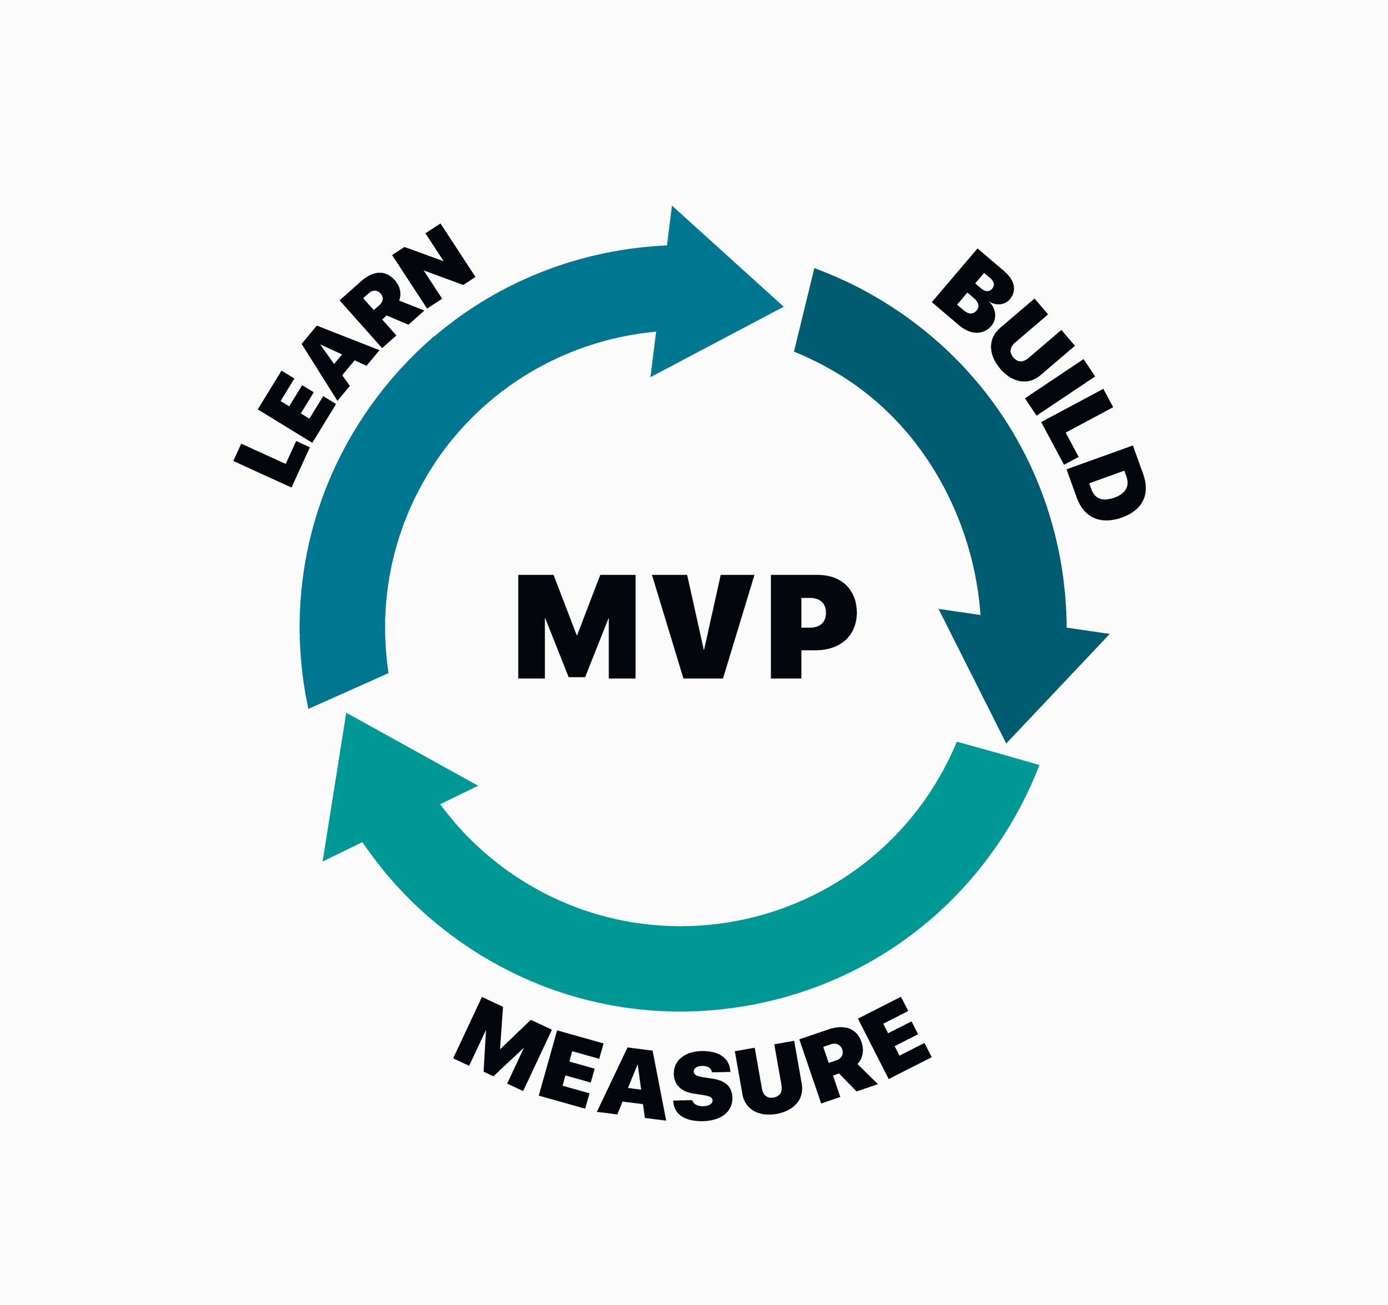
MVP: ADVANTAGES
Help you focus on the core idea
Early market entry
Early testing opportunity
Continuously updated with customer feedback
Less wastage of resource and time

Slide 17
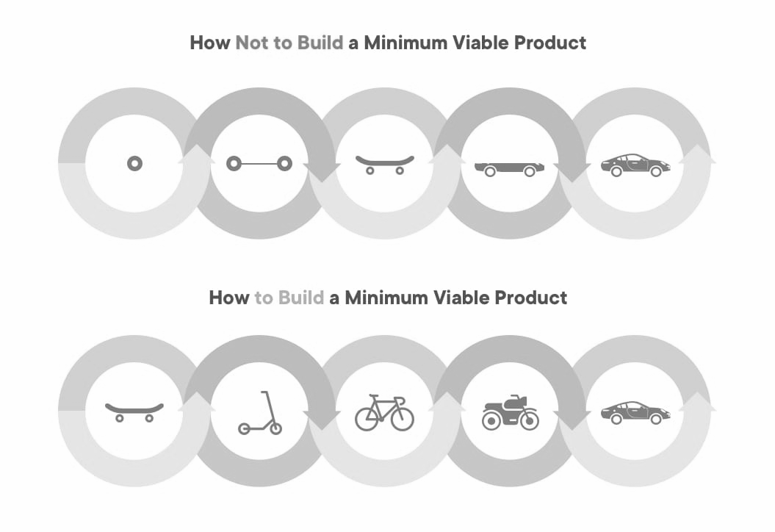
RIGHT WAY TO BUILD AN MVP
How Not to Build a Minimum Viable Product
How to Build a Minimum Viable Product
-Henrik Kniberg
MVP is not of a lower quality than the original software. It is a version with only those features necessary to implement the core functionality or idea

Slide 18
RIGHT WAY TO BUILD AN MVP
Minimum Viable Product: Development Approach
Emotional
Design
This
Emotional
Design
Not This
Usable
Usable
Reliable
Reliable
Functional
Functional
An MVP is implemented across all the layers, not just a single layer

Slide 19
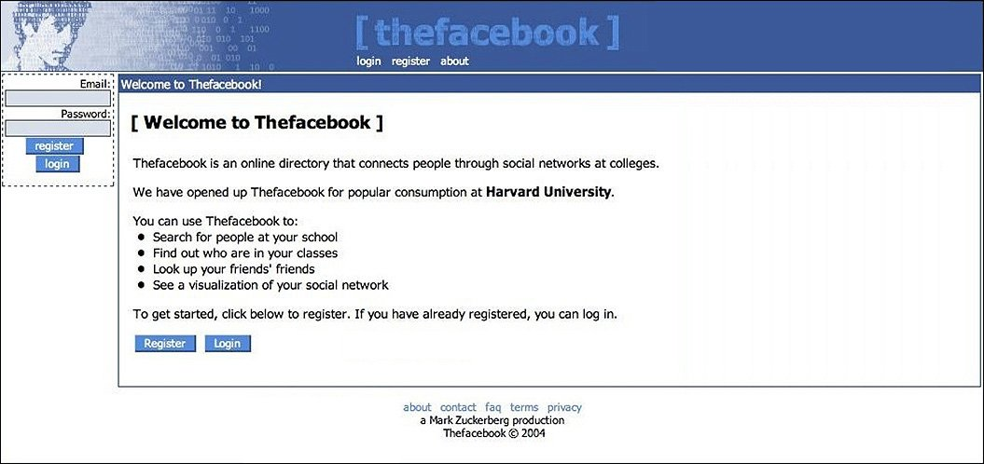
CASE STUDY: MVP
The idea was to connect friends through a social platform
Facebook

Slide 20
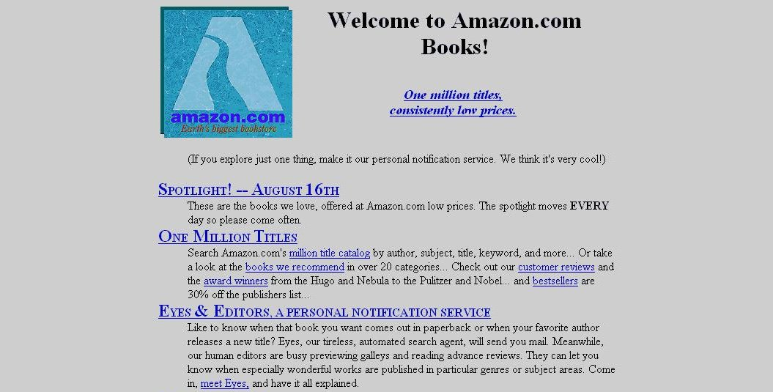
CASE STUDY: MVP
Started as a simple website for selling books online, with some basic functionalities
Amazon

Slide 21


Poll 1 (15 seconds)
Which of the following is the correct order in which an MVP, a prototype, and a POC are created?
MVP, prototype, POC
Prototype, POC, MVP
POC, prototype, MVP
POC, MVP, prototype
Practice in teams of 4 students
Industry expert mentoring to learn better
Get personalised feedback for improvements
21

Slide 22
Poll 1 (15 seconds)
Which of the following is the correct order in which an MVP, a prototype, and a POC are created?
MVP, prototype, POC
Prototype, POC, MVP
POC, prototype, MVP
POC, MVP, prototype
Practice in teams of 4 students
Industry expert mentoring to learn better
Get personalised feedback for improvements
22

Slide 23
SOFTWARE DEVELOPMENT: LIFE CYCLE
A well-defined path followed by development team from the initial stage to the final delivery of a software is called the software development life cycle (SDLC)

Slide 24
SDLC STAGES FOR A SOCIAL MEDIA USE CASE
A product idea is conceived
Mockup is built and technicalities are analyzed
Design-related decisions are taken based on requirements
Developer starts coding based on the design
Application is tested and deployed
Application is monitored and maintained

Slide 25
WHY SDLC?
01
Ensures proper planning and management to achieve the end result
02
Encourages ownership of the team throughout the process
03
Helps deliver highest-quality software while keeping track of costs and time

Slide 26
WATERFALL METHODOLOGY
The waterfall model is known as a linear-sequential life cycle model, as it requires the completion of the previous stage before starting the next one

Slide 27
WATERFALL METHODOLOGY
Requirement Gathering
System Design
Implementation
Testing
Deployment
Monitoring and Maintenance

Slide 28
WATERFALL METHODOLOGY
Advantages
Disadvantages
It is simple and easy to understand and follow
It is easy to manage owing to the rigidity of the model (each step has a checklist)
It does not involve any overlapping of the phases
It works well for small projects in which the requirements are clearly defined and well understood
Once an application is in the testing stage, it is difficult to go to the previous stage and make a modification that was not well-thought-out during the concept stage
No working software is finalized until the last stage
This method is not suitable for projects with a moderate-to-high risk of changing requirements
This should not be preferred for long and ongoing projects

Slide 29
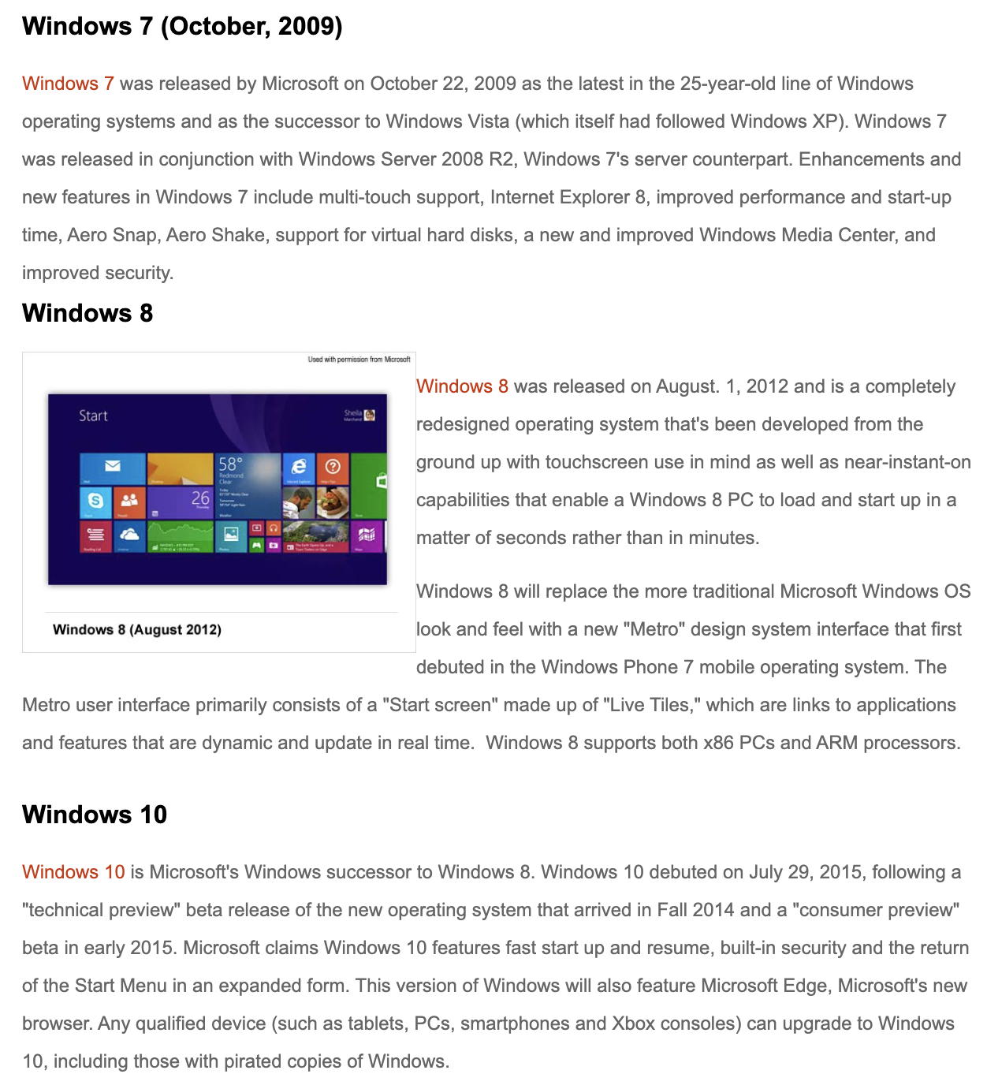

Observe how Microsoft used to release a Windows OS every few years prior to 2015

Slide 30
DRAWBACKS
Late releases
01
02
Unresolved issues
03
Delayed feedback and implementation
04
Security concerns
05
More regressive planning and requirements gathering process

Slide 31
AGILE METHODOLOGIES
The Agile development model is iterative and incremental and can produce quality software
Agile is an umbrella term for several iterative and incremental software development approaches
The most popular Agile frameworks include Scrum and Feature-driven development

Slide 32
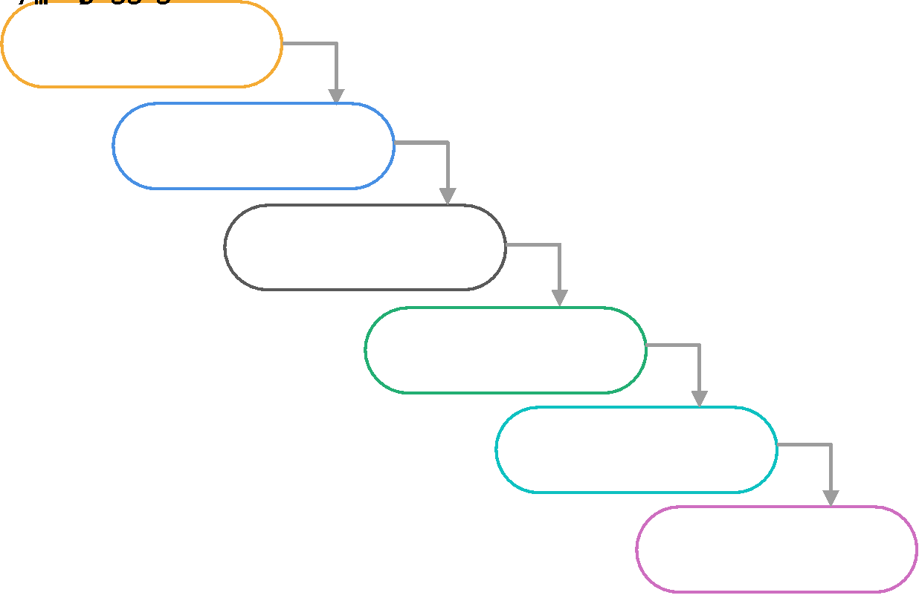
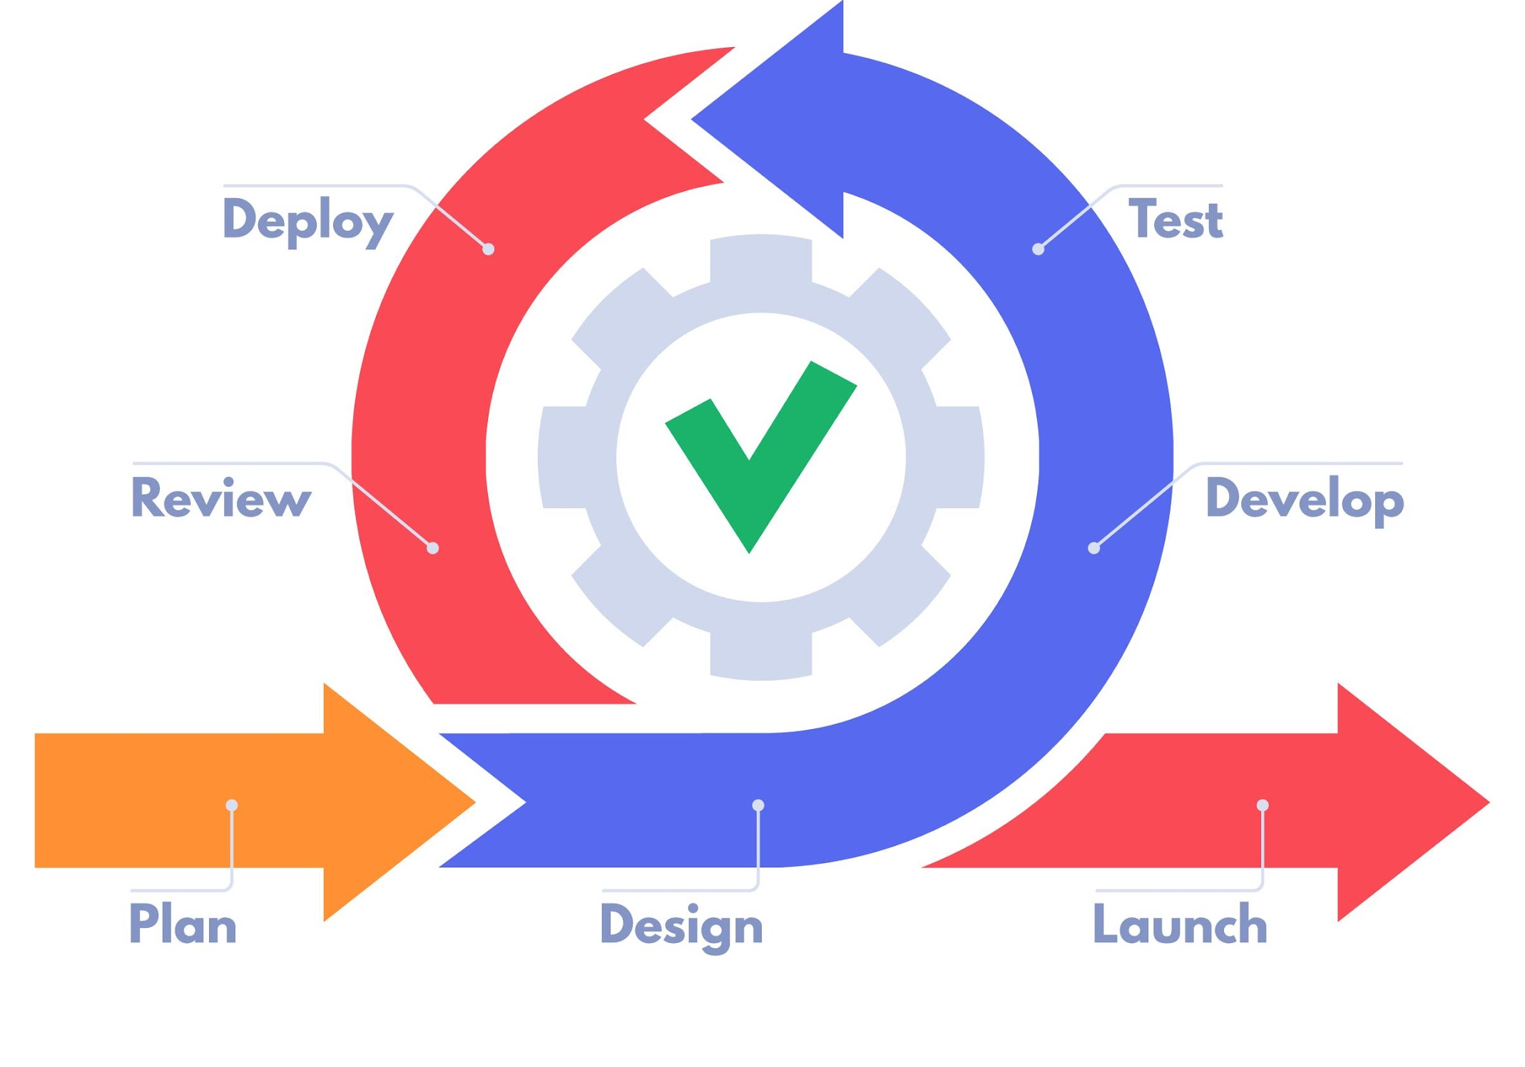
WATERFALL
AGILE FRAMEWORK

Slide 33
AGILE FRAMEWORK
A product is developed iteratively and incrementally in short cycles
Every iteration involves cross-functional teams working simultaneously on various areas

Slide 34

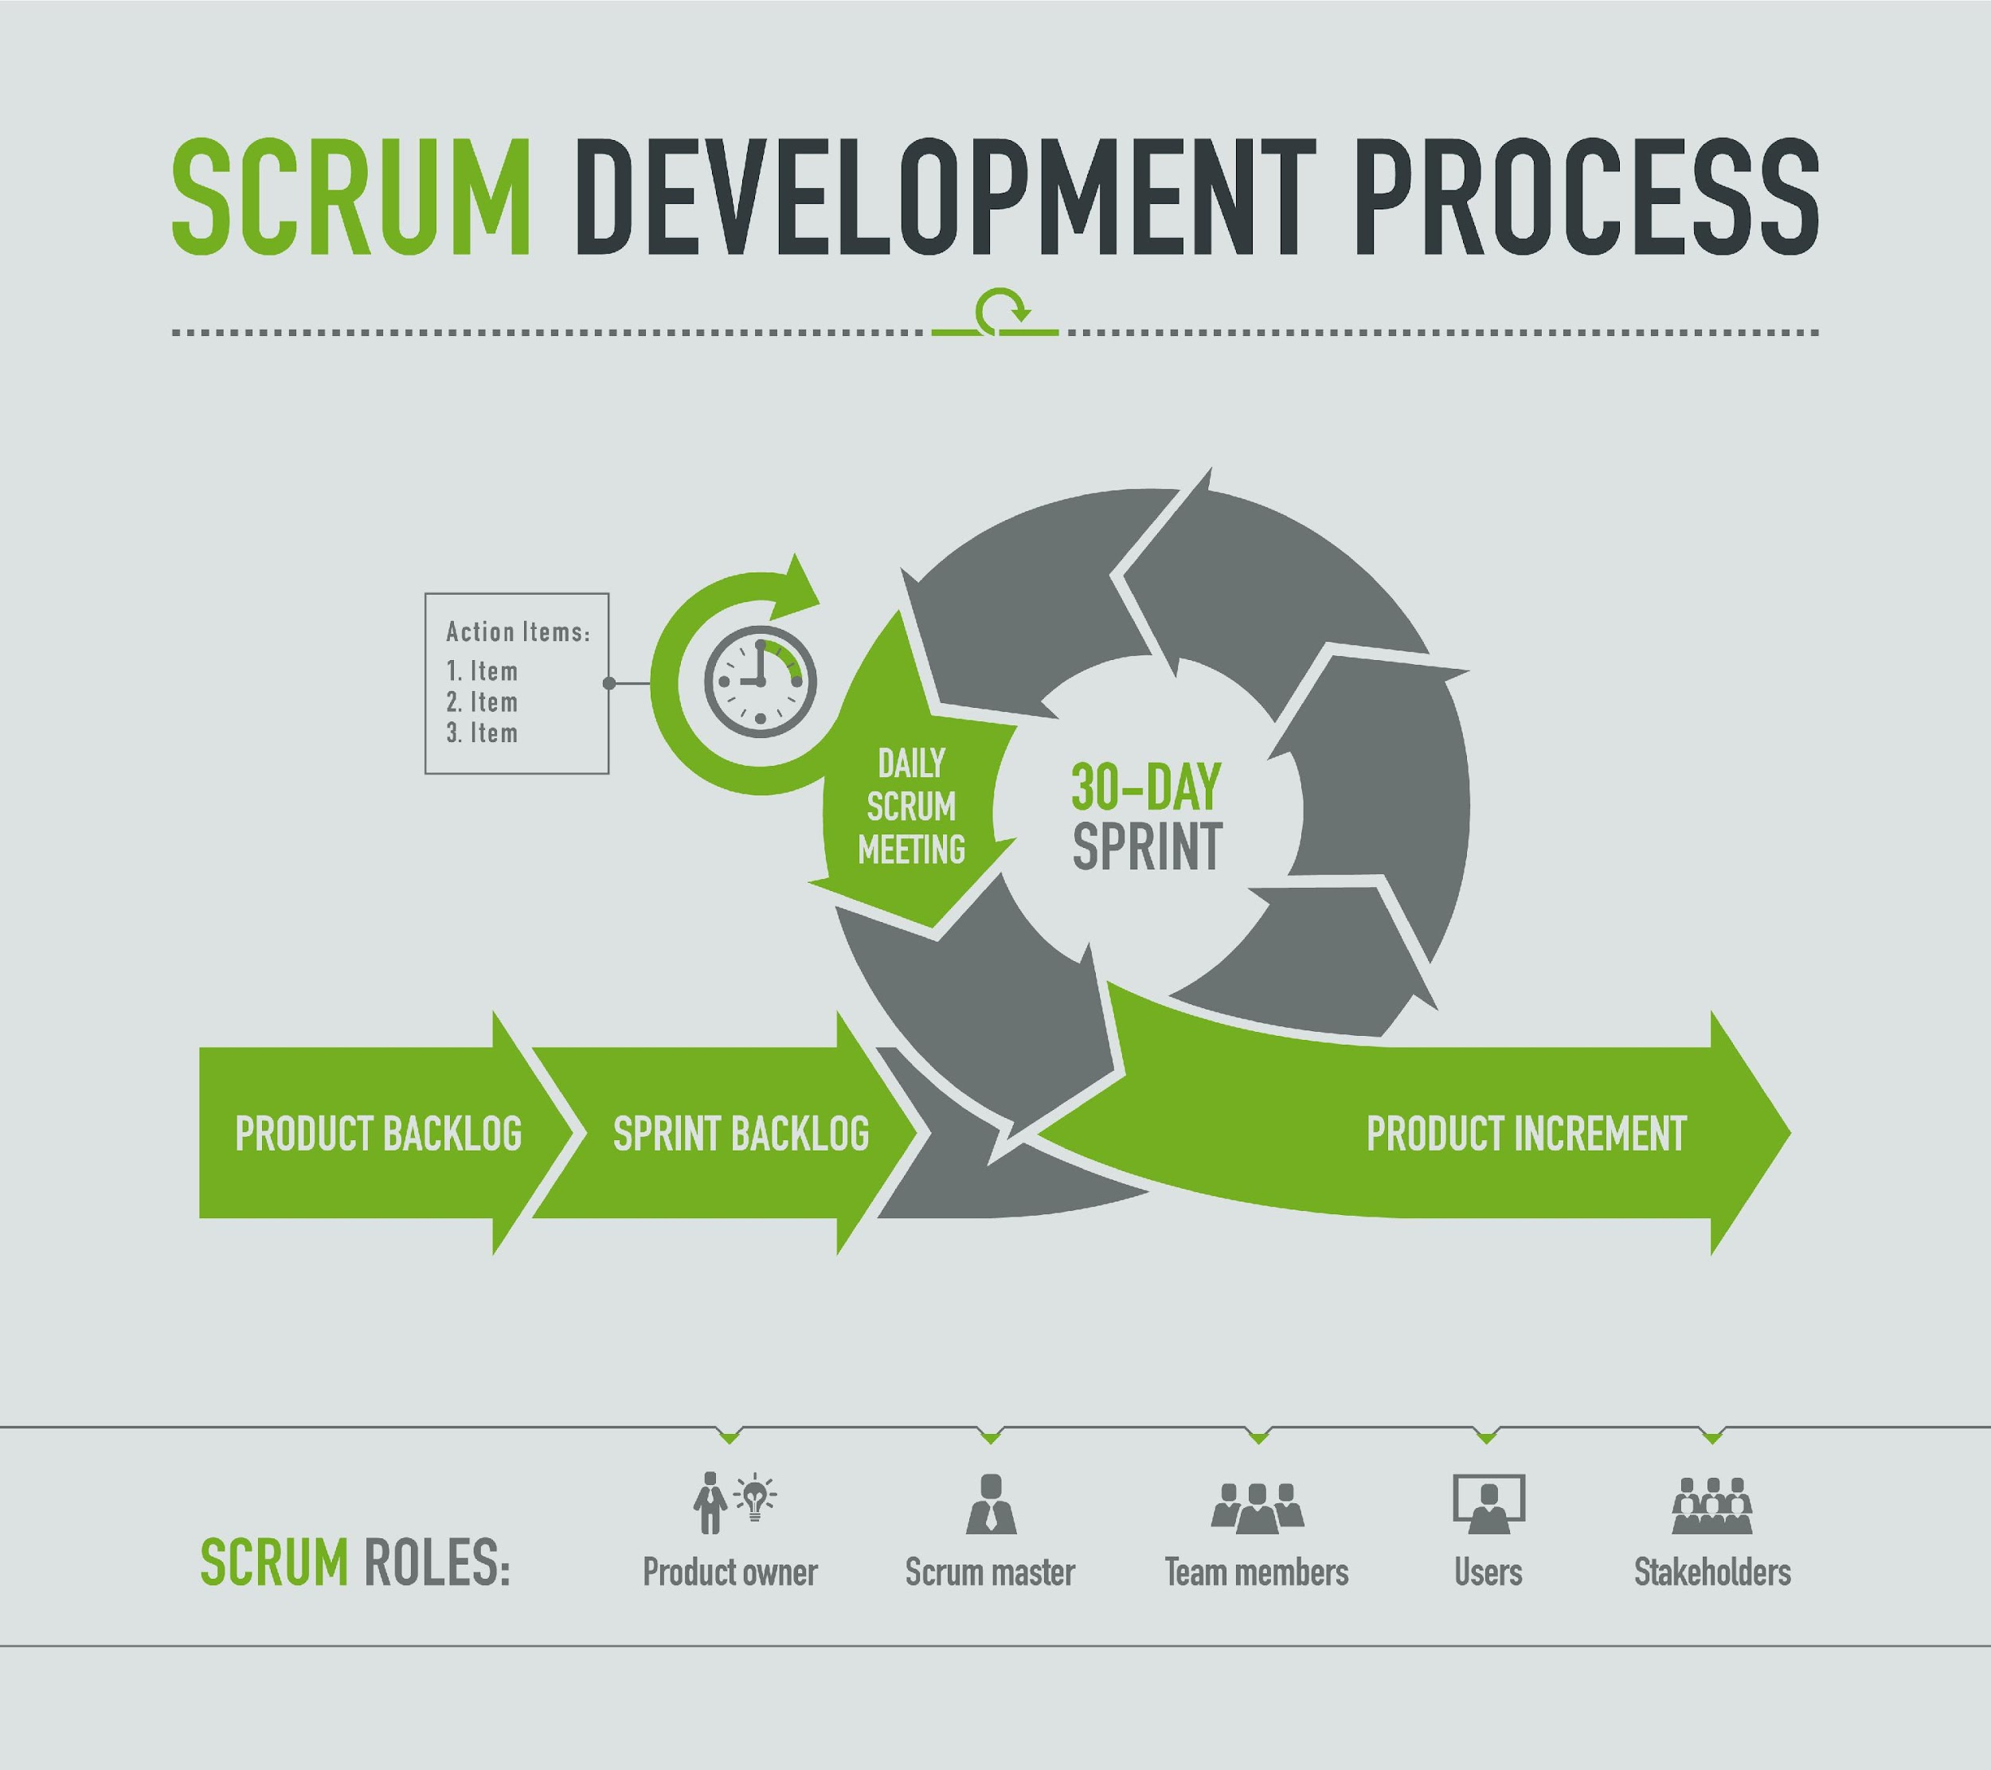
AGILE SCRUM
Scrum
Scrum is an Agile method
A product is launched in multiple iterations, each of approximately 30 days - these are called sprints
A to-do-list of items is called a product backlog
An item included in a sprint is called a sprint backlog
At the end of each sprint, something shippable is produced
The final event is called a sprint retrospective - they discuss ways to improve their processes, team communication, tools, skills, etc.

Slide 35
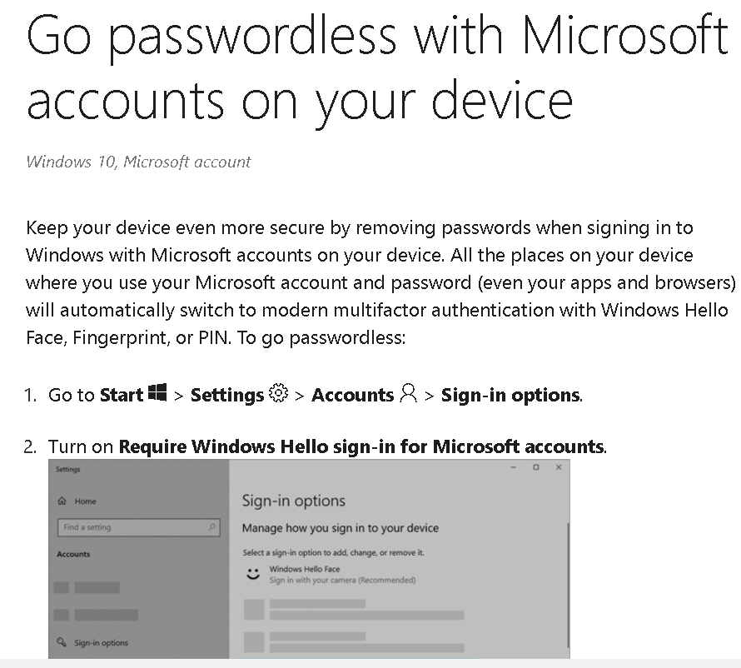
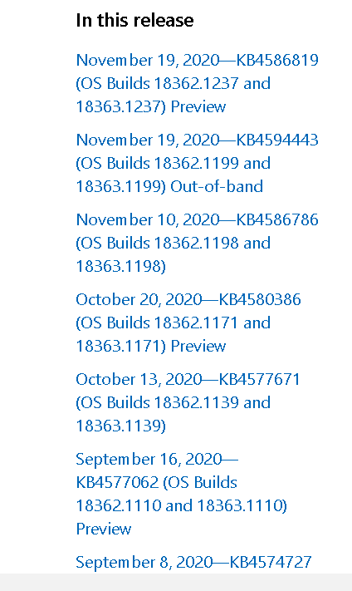
Observe how Microsoft updates now: “Going passwordless” feature

Slide 36
MVP: WATERFALL VS AGILE METHODS
Intuitively, the waterfall model does not seem to be suitable to achieve the MVP motive, as it would require a lot of time to produce software, and by then, either the market would have changed or your idea would no longer be business-viable
Where software are produced to address security concerns, such as DRDO, a full checklist will need to be followed and the documentation of the software will need to be maintained. So, the waterfall model will be easy and intuitive for them

Slide 37
WATERFALL VS AGILE METHODS
Case | Waterfall | Agile
Frequent changes
Competitive industry
Monopoly
Efficiency and productivity | -
Rigid project timeline
Mandatory documentation
NO
YES
NO
YES
YES
NO
MAY BE
YES
YES
NO
YES
NO

Slide 38
Poll 2 (15 seconds)
Which of the following is an advantage of the waterfall method?
It is a great model for long ongoing projects
It is suitable for projects with uncertain requirements
It works well for projects with fixed requirements and timelines
Using this method, no working software is produced until the last stage of the cycle
Practice in teams of 4 students
Industry expert mentoring to learn better
Get personalised feedback for improvements
38

Slide 39
Poll 2 (15 seconds)
Which of the following is an advantage of the waterfall method?
It is a great model for long ongoing projects
It is suitable for projects with uncertain requirements
It works well for projects with fixed requirements and timelines
Using this method, no working software is produced until the last stage of the cycle
Practice in teams of 4 students
Industry expert mentoring to learn better
Get personalised feedback for improvements
39

Slide 40
Poll 3 (15 seconds)
Fill in the blank in the following sentence
Each iteration of software development in the Scrum framework is called _________
Product backlog
Sprint
Epic
To-do-list
Practice in teams of 4 students
Industry expert mentoring to learn better
Get personalised feedback for improvements
40

Slide 41
Poll 3 (15 seconds)
Fill in the blank in the following sentence
Each iteration of software development in the Scrum framework is called _________
Product backlog
Sprint
Epic
To-do-list
Practice in teams of 4 students
Industry expert mentoring to learn better
Get personalised feedback for improvements
41

Slide 42
DEV VS OPS
To become more agile, Dev teams start producing increments frequently
The difference in environments caused by different configurations, dependencies, and data at the different stages of development cause things to break
Changes that could break the system are pushed frequently by Dev teams, which poses challenges to the Ops teams, as they need to the keep production environment stable and in working condition
To solve this issue, Ops teams introduce checklists which slow down the process

Slide 43
COMMON DEPLOYMENT ISSUES
Difference in Prod and Dev environments
Dev teams need agility, but Ops teams need stability
Rolling back takes time: No record of states
Manual deployment of thousands of servers
Resource management and scaling issues
Breaking of code owing to wrong commit

Slide 44
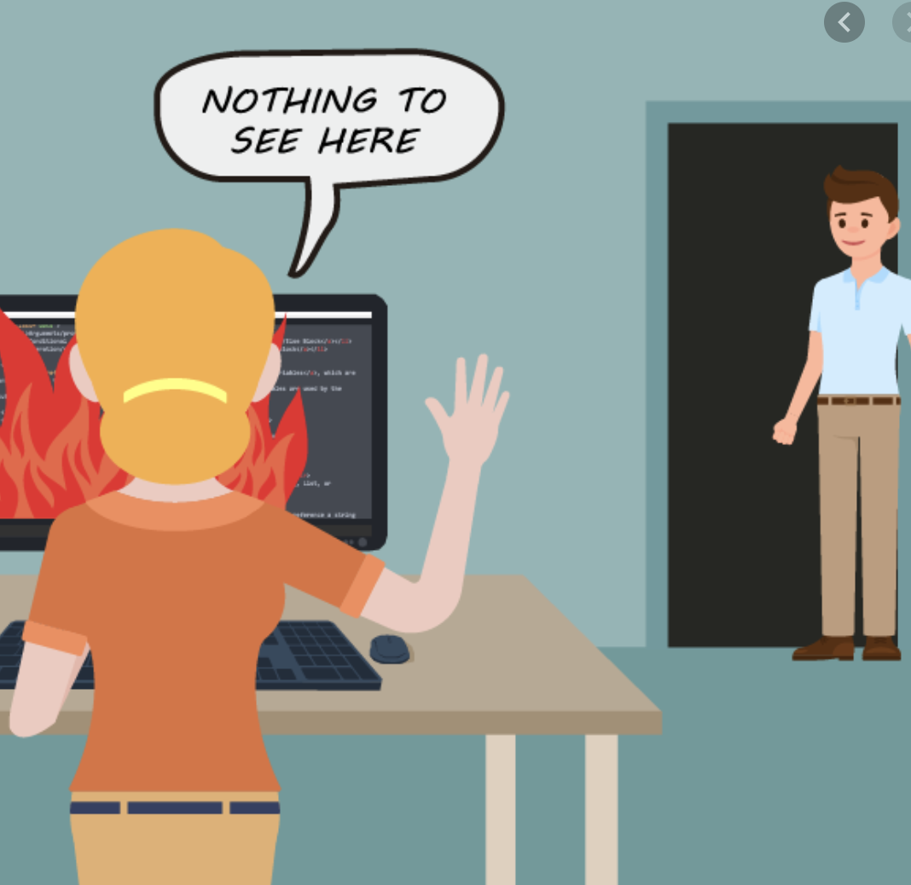
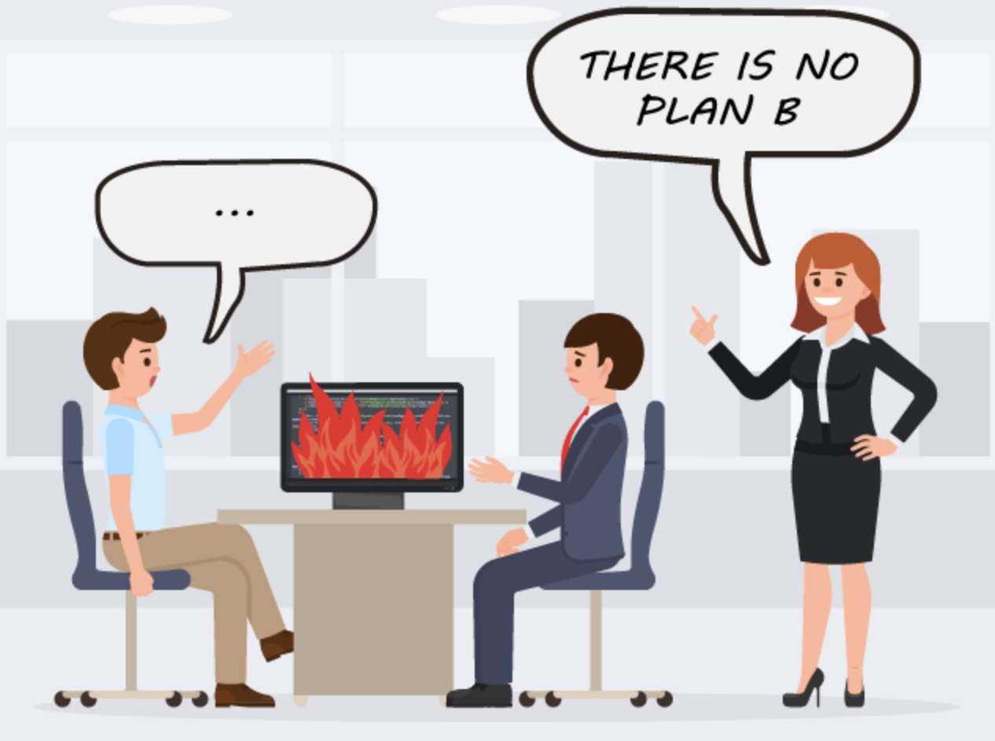
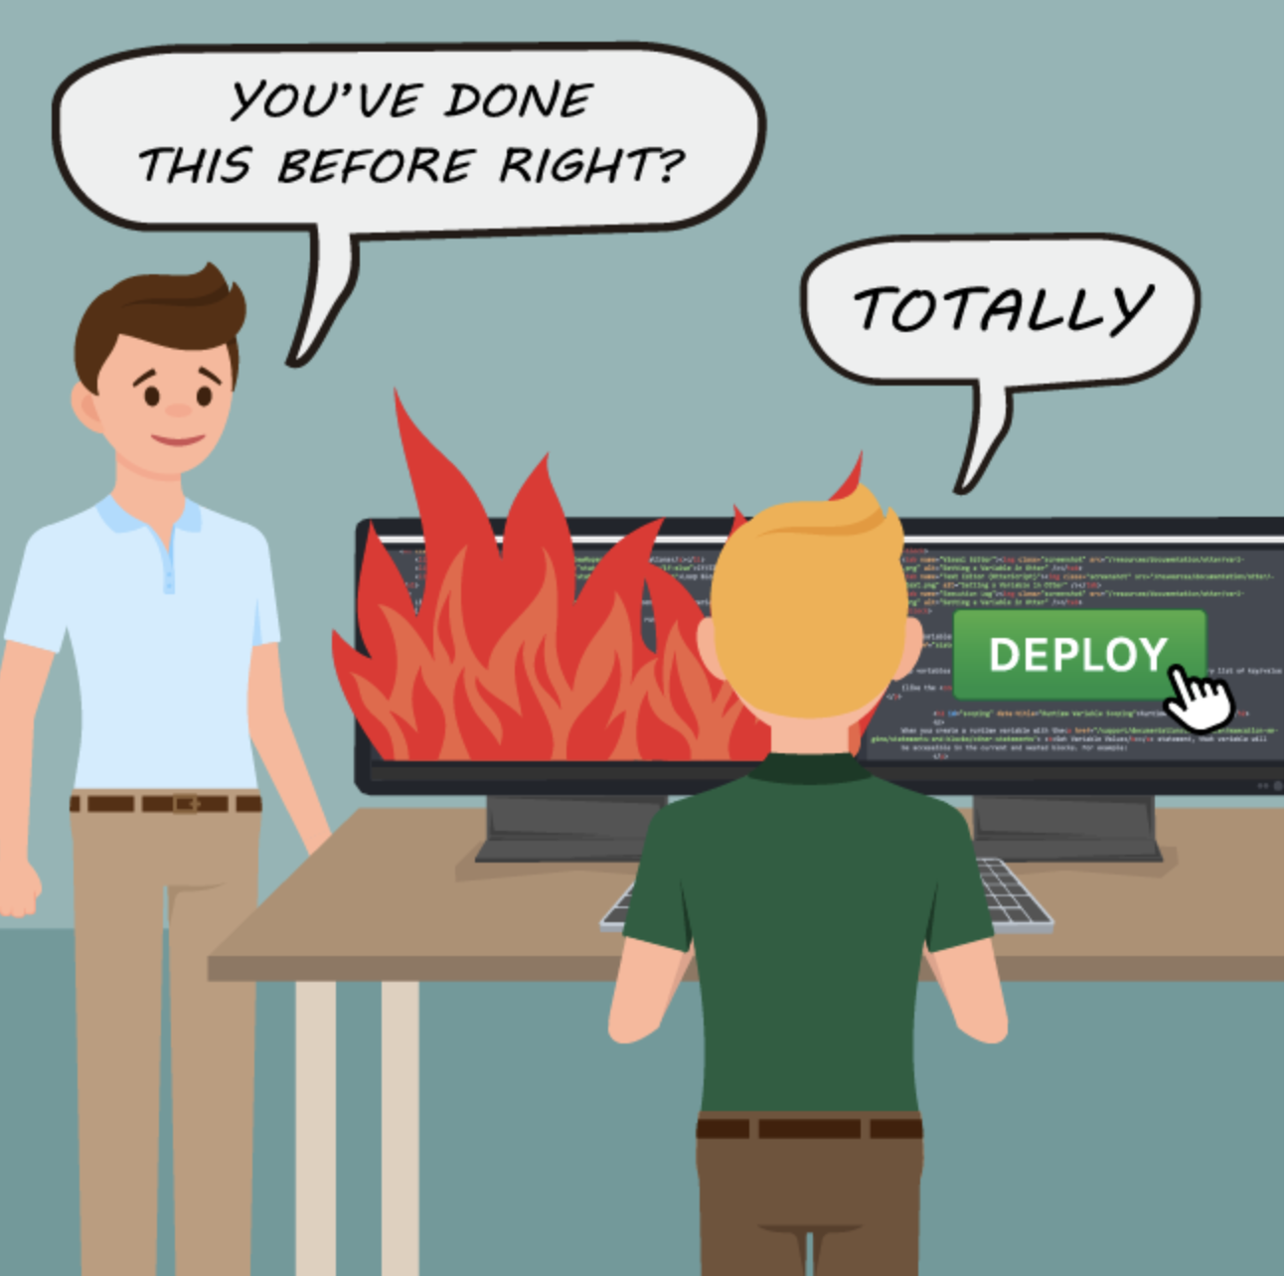
DEPLOYMENT ISSUES
Source: https://blog.inedo.com/blog/deployment-failures

Slide 45
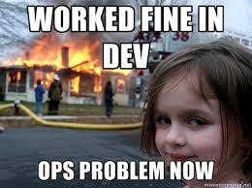
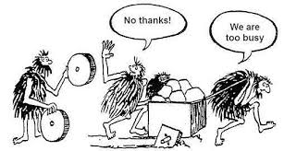
CROSS-FUNCTIONAL TEAM ISSUES
Source: Online resources

Slide 46
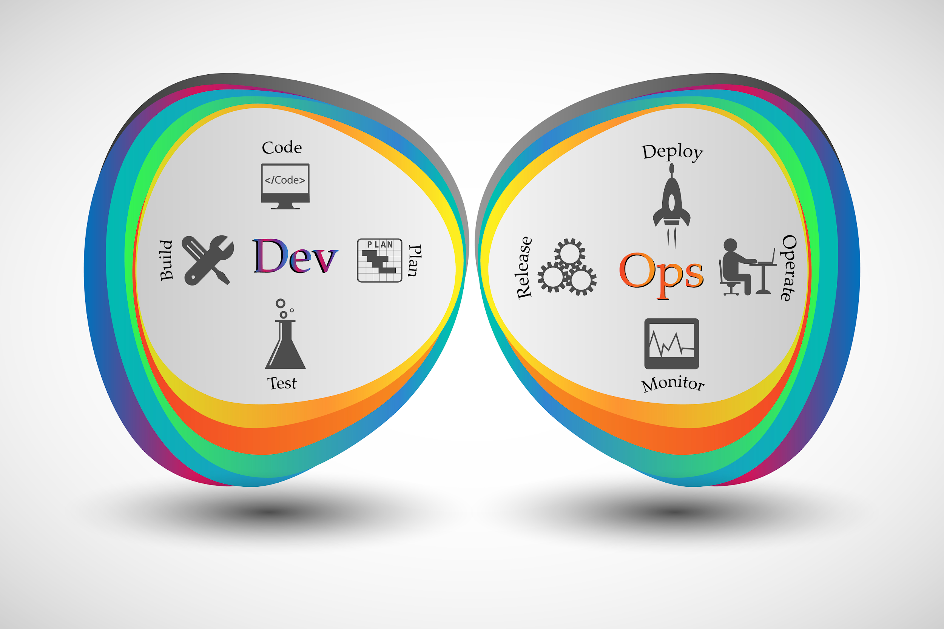
WHAT IS THE SOLUTION TO THESE PROBLEMS?
Resolving conflicts and deployment issues requires a close collaboration between the Dev and Ops teams using automation tools and principles known as the DevOps methodology

Slide 47
SESSION SUMMARY:
MINIMUM VIABLE PRODUCT
Concept of a Minimum Viable Product
Advantages of MVP
Software development life cycle (SDLC)
Waterfall methodology
Agile methodologies
Deployment issues

Slide 48

Minimum Viable Product
Introduction to DevOps
DevOps Road Map

Slide 49
SESSION OVERVIEW:
INTRODUCTION TO DEVOPS
DevOps and its definition
Problems solved by DevOps
DevOps principles and core values
Development of an MVP with DevOps best practices
DevOps case study and future of DevOps
Common DevOps myths

Slide 50
WHY DEVOPS?
In Agile organizations, the Dev team continues pushing new releases frequently
The Ops team also needs to deploy these changes frequently so that they reach customers on time
The Ops team also ensures that the system is stable and always functioning

Slide 51
WHAT IS DEVOPS?
“
DevOps is the combination of cultural philosophies, practices, and tools that increases an organization’s ability to deliver good quality applications and services at high velocity
“
- Amazon.com

Slide 52

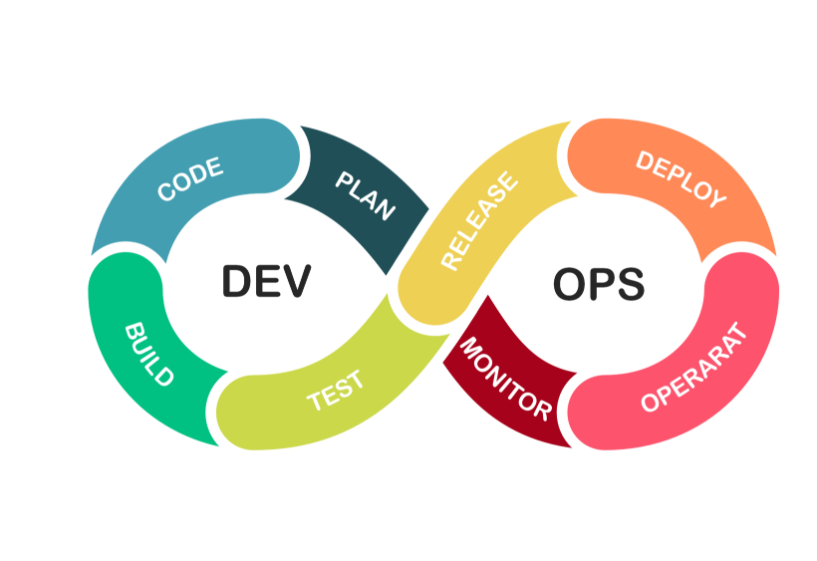

DEVOPS

Slide 53
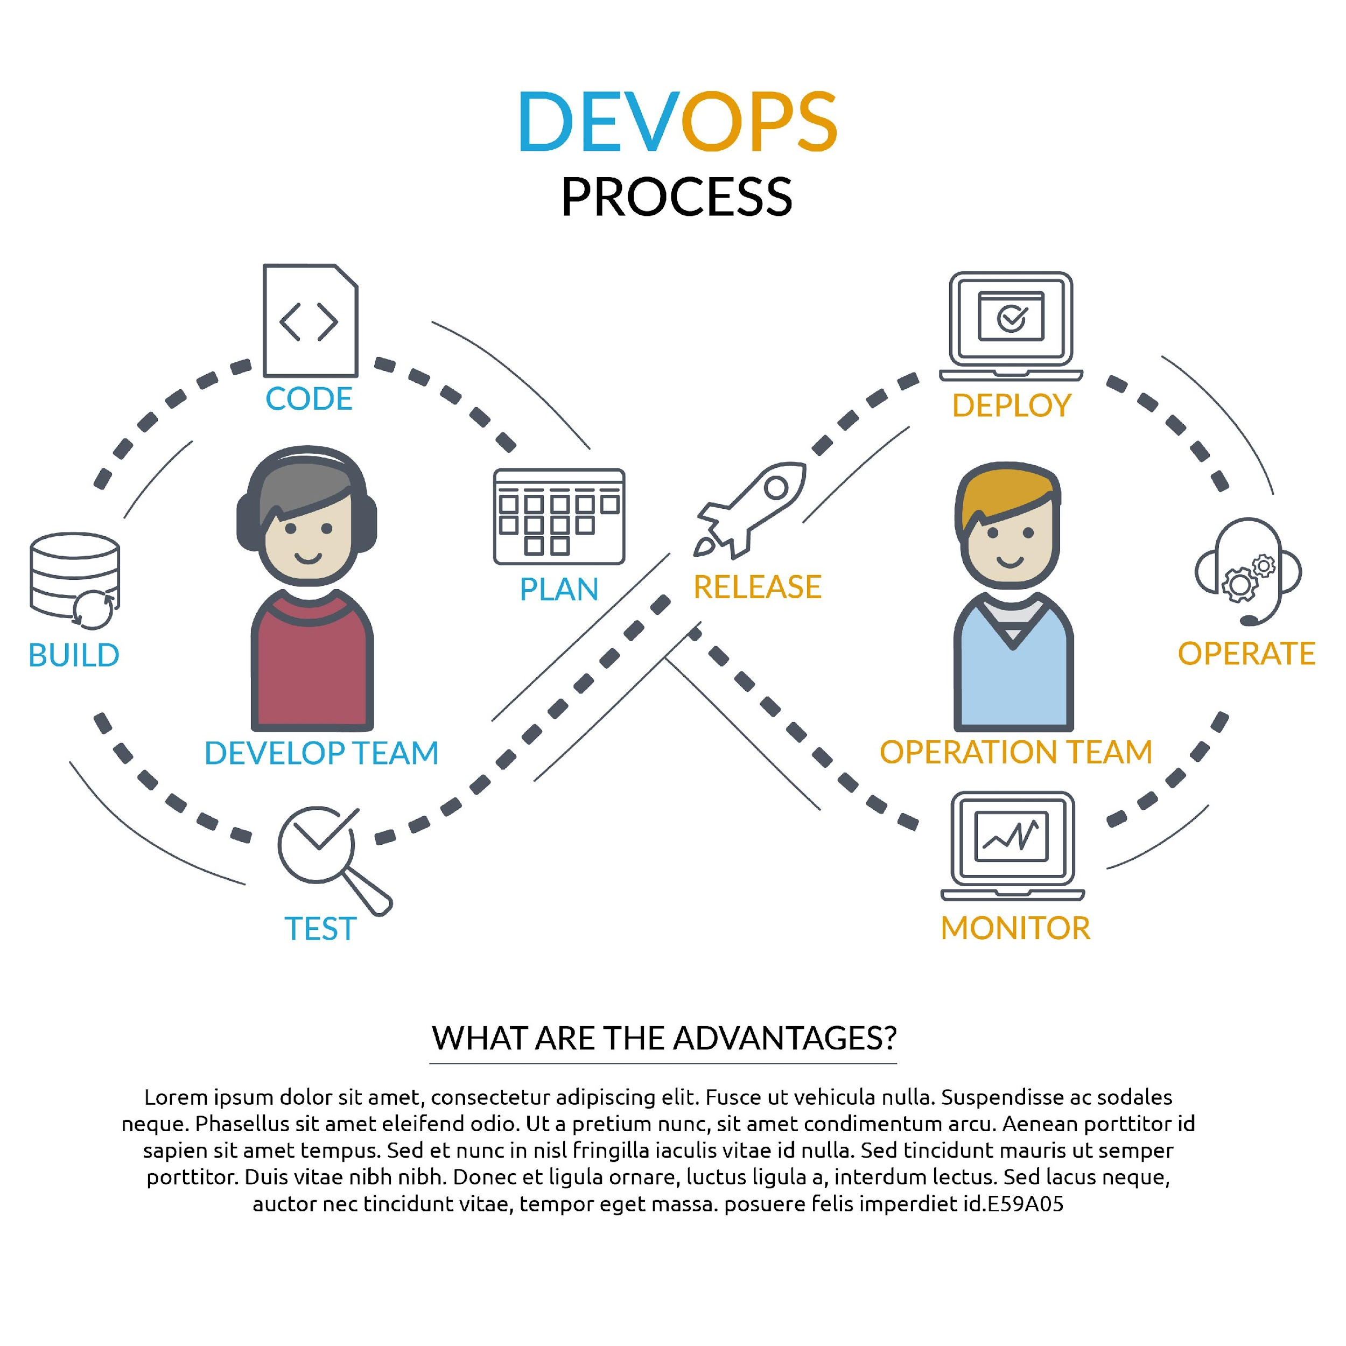
DEVOPS CYCLE
In agile methodologies, the design, build, and testing is continuous, but the deployment is still linear
DevOps is denoted by an infinite loop because it uses automation tools for automatic deployment, monitoring and feedback, and making the entire process continuous and infinite

Slide 54
DEVOPS CYCLE
CI/CD PIPELINE
Continuous Integration
Continuous Delivery
Continuous Deployment

Slide 55
DEVOPS STAGES: CONTINUOUS INTEGRATION
Continuous Integration
01
Developer focuses on productive work
Developers regularly merge their code changes into a source code repository such as Git
When a code change is detected, it is pulled, and then, automated builds and tests are run
Unit testing and integration testing are carried out automatically
02
Testing with each commit helps find and resolve bugs quickly
03
Faster delivery of updates

Slide 56
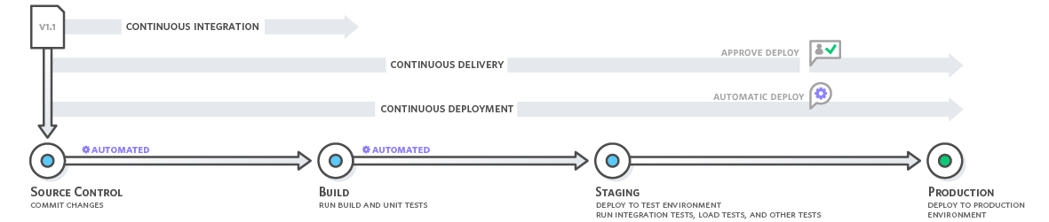
DEVOPS STAGES: CONTINUOUS DELIVERY/DEPLOYMENT

Slide 57
DEVOPS STAGES: CONTINUOUS DELIVERY/DEPLOYMENT
Continuous delivery/deployment is an extended version of continuous integration in which code changes are deployed to a testing server and/or a production environment after the build stage
Automatic release of a software
Continuous delivery enables you to perform additional types of easily such as API reliability testing, load testing, and UX/UI testing
In continuous delivery, each code change is built, tested, and pushed to a non-production testing or staging environment. However, manual approval is required for deploying it on the production server
In continuous deployment, the deployment on the production server occurs without any approval

Slide 58
CONTINUOUS DELIVERY AND CONTINUOUS DEPLOYMENT
Manual
Automatic
Continuous Integration
Continuous Delivery
Build
Test
Acceptance test
Deployment to staging
Deploy to production
Smoke test
Build
Test
Acceptance test
Deployment to staging
Deploy to production
Smoke test
Continuous deployment

Slide 59
Poll 4 (15 seconds)
Which of the following statements is correct regarding continuous deployment and continuous delivery?
In continuous delivery, every code change is built, tested, and then pushed to a non-production or staging environment
In continuous delivery, every code change is ONLY compiled and tested
In continuous deployment, every code change is built, tested, and then pushed to a staging and production environment without any manual approval
In continuous delivery, every code change is built, tested, and pushed to a staging environment and then to the production environment with manual approval
Practice in teams of 4 students
Industry expert mentoring to learn better
Get personalised feedback for improvements
59

Slide 60
Poll 4 (15 seconds)
Which of the following statements is correct regarding continuous deployment and continuous delivery?
In continuous delivery, every code change is built, tested, and then pushed to a non-production or staging environment
In continuous delivery, every code change is ONLY compiled and tested
In continuous deployment, every code change is built, tested, and then pushed to a staging and production environment without any manual approval
In continuous delivery, every code change is built, tested, and pushed to a staging environment and then to the production environment with manual approval
Practice in teams of 4 students
Industry expert mentoring to learn better
Get personalised feedback for improvements
60

Slide 61
DEVOPS PRINCIPLES
DevOps: Principle of cooperation between the Dev and Ops teams
DevOps follows agile principles
Building pipelines to deliver faster with minimal wastage of resources
DevOps enables end-to-end agility with faster and stable deployments

Slide 62
DEVOPS PRINCIPLES
In the fictional book The Phoenix Project on a DevOps transformation in a company, the following “Three Ways” describe the principles of DevOps:
Systems thinking: Emphasis on the performance of whole systems rather than their part
Amplifying feedback loops: If code is broken, it should return to the Dev as soon as possible
Culture of continuous experimentation and learning: Create a culture to encourage risk-taking and learning

Slide 63

DEVOPS PRINCIPLES
Create with an end goal in mind
Customer-centric
Cross-functional autonomous teams
End-to-end responsibility
Automate the maximum number of processes
Continuous experimentation

Slide 64
DEVOPS: CALMS FRAMEWORK
C
CULTURE: Embrace change from the heart and mind
A
AUTOMATION: CI/CD; Infrastructure as a Code
L
LEAN: Producing value for the end user; small batches
M
MEASURE: Measure everything; show improvement
S
SHARING: Open minded; collaborative

Slide 65

DEVOPS BEST PRACTICES
Using the Version Control System
Continuous Integration and Delivery
Containerization

Slide 66
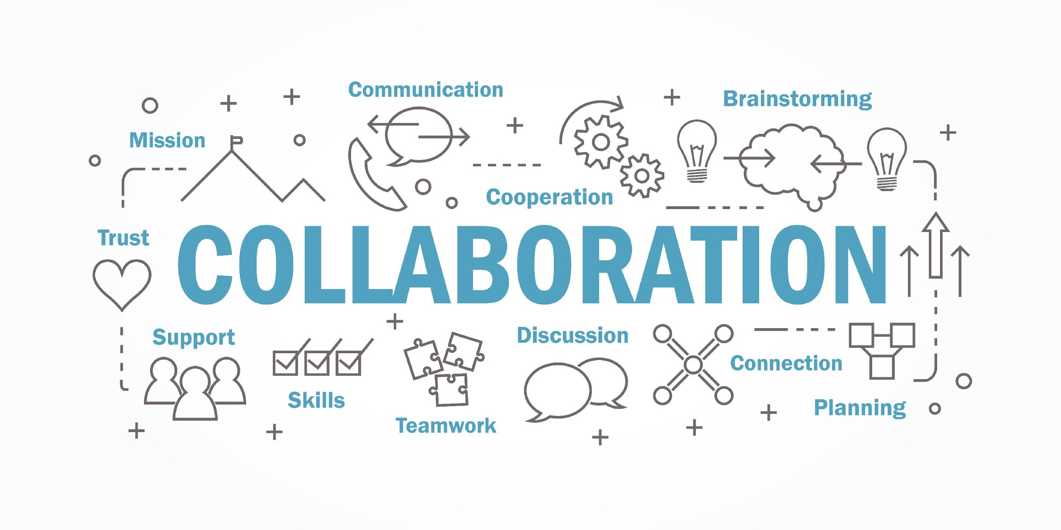
DEVOPS BEST PRACTICES
Infrastructure as a Code
Continuous Monitoring
Communication and Collaboration

Slide 67
DEVOPS: ACCELERATING FROM AN MVP TO A PRODUCT
An MVP is built with an assumption and is subjected to changes at various stages of its development
Continuous integration and continuous delivery (CICD) tools increase the velocity of updates and help deliver according to the market dynamics
With time, the demand will increase, and you must scale your MVP. DevOps with IaaC and Containerization ease this scaling
If customer needs are different, with the microservice architecture, you can easily update and deploy without significant downtime
Inculcating the DevOps culture from the starting stage of MVP can help accelerate the development toward the final product

Slide 68

CASE STUDY: NETFLIX - RESILIENCE
Started as a DVD renting company
Currently has 128 million subscribers
In 2011, it invented Chaos Monkey that randomly kills servers
A system to build resilience in its infrastructure

Slide 69

CASE STUDY: POKÉMON GO - SCALABILITY
Scaled up in record time: Within a few days of its release, it attracted more users than Twitter:
Search capture and train Pokemon characters: Handles zettabytes of data every day
Processes a large amount of data in real time
Automated end-to-end DevOps pipelines expedited multiple iterations of testing and development

Slide 70


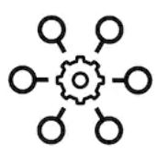

DEVOPS: FUTURE
DevOps in the security field
AI/ML in the DevOps Framework
Automation for Every Company
Platform as a Service (PaaS)

Slide 71
DEVOPS: MYTHS
1
DevOps is a technology
CI/CD delivers every 5 minutes
2
5
DevOps Does not work on Complex systems
3
DevOps means Cloud
DevOps means NoOps
4

Slide 72
Poll 5 (15 seconds)
Which of the following techniques makes DevOps a successful methodology to develop and deliver software?
DevOps enables you to quickly identify, fix, and learn from errors
DevOps enables you to organize your teams around your organizational mission
DevOps enables you to create your software with built-in quality and monitoring
All of the above
Practice in teams of 4 students
Industry expert mentoring to learn better
Get personalised feedback for improvements
72

Slide 73
Poll 5 (15 seconds)
Which of the following techniques makes DevOps a successful methodology to develop and deliver software?
DevOps enables you to quickly identify, fix, and learn from errors
DevOps enables you to organize your teams around your organizational mission
DevOps enables you to create your software with built-in quality and monitoring
All of the above
Practice in teams of 4 students
Industry expert mentoring to learn better
Get personalised feedback for improvements
73

Slide 74
SESSION OVERVIEW:
INTRODUCTION TO DEVOPS
What is DevOps
Continuous integration and delivery
Principle and core values: CALMS framework
Infrastructure as a code
Case studies: Netflix and Pokémon Go
Applications of DevOps in the future and myths related to DevOps

Slide 75
Minimum Viable Product
Introduction to DevOps
DevOps Road Map

Slide 76
DEVOPS ROAD MAP
On completing this, you will learn:
The necessary tools and technology to excel in DevOps
The roles and responsibilities of a DevOps engineer in the industry

Slide 77
DEVOPS ROAD MAP
Learn programming and scripting
Understand different OS concepts and Linux
Setting up a machine
-Linux and Networking
- Servers and Load balancers
Containerization
CI/CD Tools
Version Control
Cloud Services
Infrastructure as a Code
Continuous Monitoring tools

Slide 78
DEVOPS ROAD MAP
Learn Programming Language
Python
Java
Ruby
C++
JavaScript
Rust
Go

Slide 79
DEVOPS ROAD MAP
OS Fundamentals
Device I/O management
Virtualization
Memory and storage management
File system architecture
Distributed file system
Process management
Thread and concurrency
Sockets

Slide 80
DEVOPS ROAD MAP
Setting up Machine
Linux fundamentals
Administration
Learn Bash scripting
Text editors such as Vi/Nano
Text manipulation: awk, sed, grep, sort, uniq, cat , cut , echo , fmt, tr, egrep, fgrep
Process monitoring: ps, top, htop, lsof, atop
Network: ping, namp, tcpdump, mtr, traceroute, dig, iptable
Networking fundamentals
DNS, IP addresses, SSH, telnet
OSI: Models
TCP/IP, HTTP, SSL
Setting up servers
Load balancers
Proxy server: Caching servers, Reverse proxy, Firewalls
Installing Tomcat, Apache, and Nginx
CDN

Slide 81
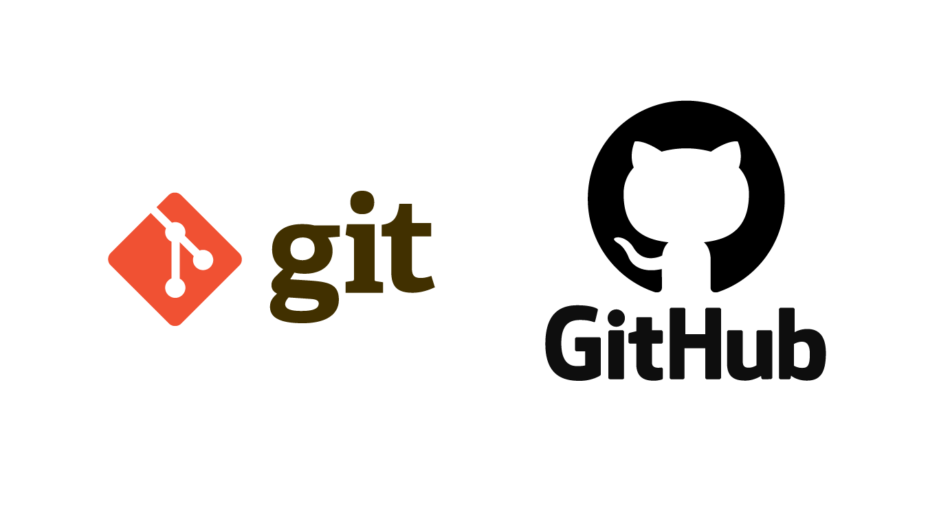

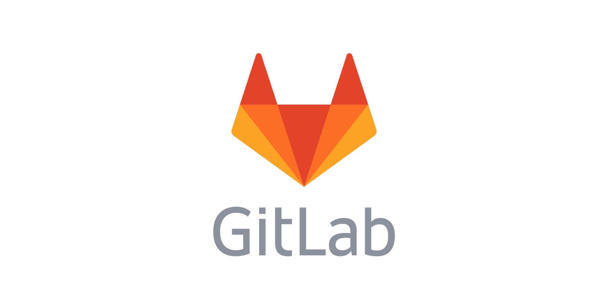
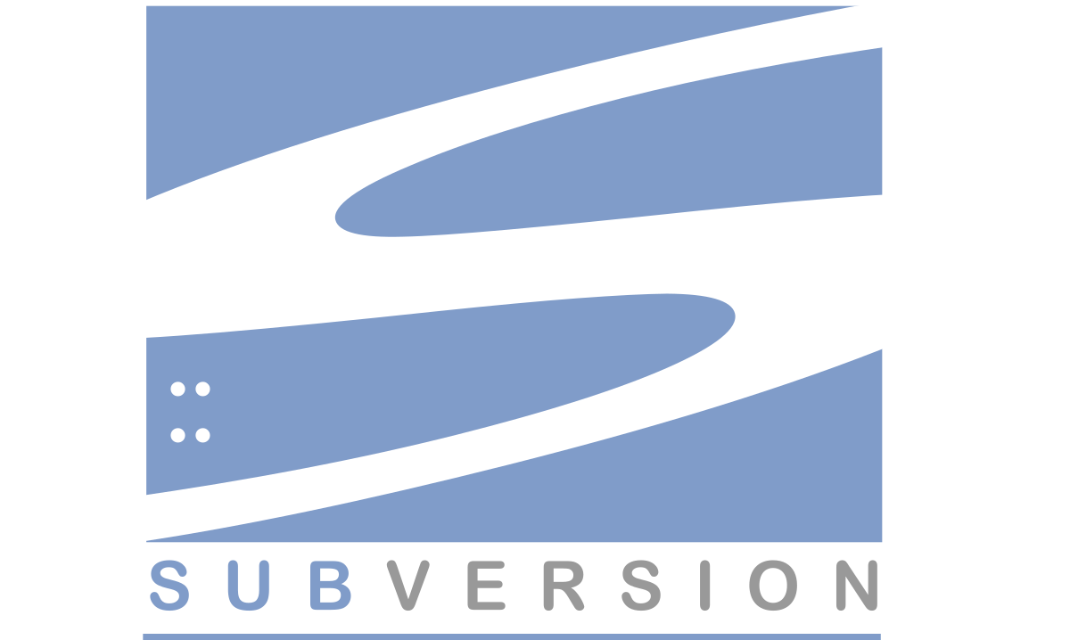

DEVOPS ROAD MAP
Version Control
Source code management tools help us keep track of changes in code
Multiple developers work in parallel, and wrong code can break things. SCM tools help to revert this
Git, SVN, CVS, and Mercurial are source code management tools
Git is an open source distributed version control system
GitHub, GitLab, and Bitbucket are online Git repositories

Slide 82

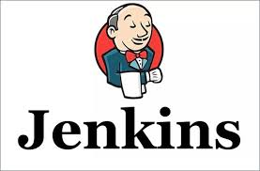
DEVOPS ROAD MAP: CD/CD TOOLS
When a developer makes changes in the code, tools such as Jenkins pull the code from the Git repository and then, build, test, and deploy the artifact on the staging and production server
Commit
a change
Trigger
build
Build
Notify of
the build
outcome
Deploy
where
necessary
Deliver
build to
the environment
Notify of
the test
outcome
Run tests

Slide 83
Continuous Deployment
Review
Staging
Production
Build
Unit Test
Commit
Integration test
Continuous Integration

Slide 84
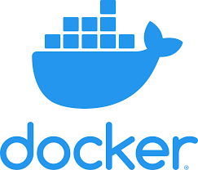

CONTAINERIZATION

Slide 85
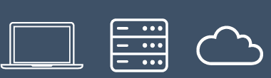
DEVOPS ROAD MAP
Containerization
Container
OS-level virtualization contains the right amount of OS required to run an application in it
Isolated
Shippable
Optimized resource utilization
Consistent environment throughout the software development stages
A text Dockerfile can be used to create a container
Cloud Foundry, Docker, and Rocket are famous containerization tools
App 1
App 2
App 3
Bins/Libs
Bins/Libs
Bins/Libs
Guest OS
Guest OS
Guest OS
App 1
App 2
App 3
Bins/Libs
Bins/Libs
Bins/Libs
Hypervisor
Docker Engine
Operating System
Operating System
Infrastructure
Infrastructure

Slide 86
THREE-TIER ARCHITECTURE
Frontend
Backend
USER
Database
MASTER

Slide 87
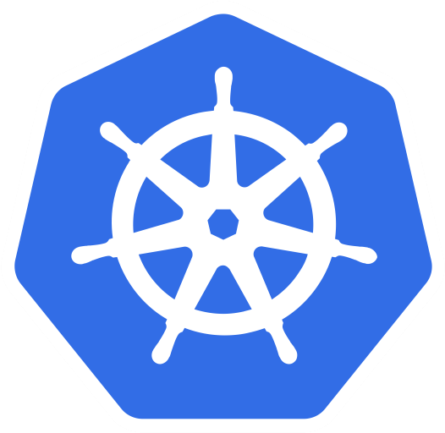
DEVOPS ROAD MAP
Container Orchestration
Helps in deployment
Manages load and auto-scales
Manages communication and networking between containers
Exposes capabilities to perform logging, analytics, and health monitoring for containers
Plugins for monitoring tools
Kubernetes and Docker-swarm are some examples

Slide 88
CONTAINER ORCHESTRATION
Governance
Security
Automation
Orchestration
Container
Open and Extensible
Image format and runtime

Slide 89
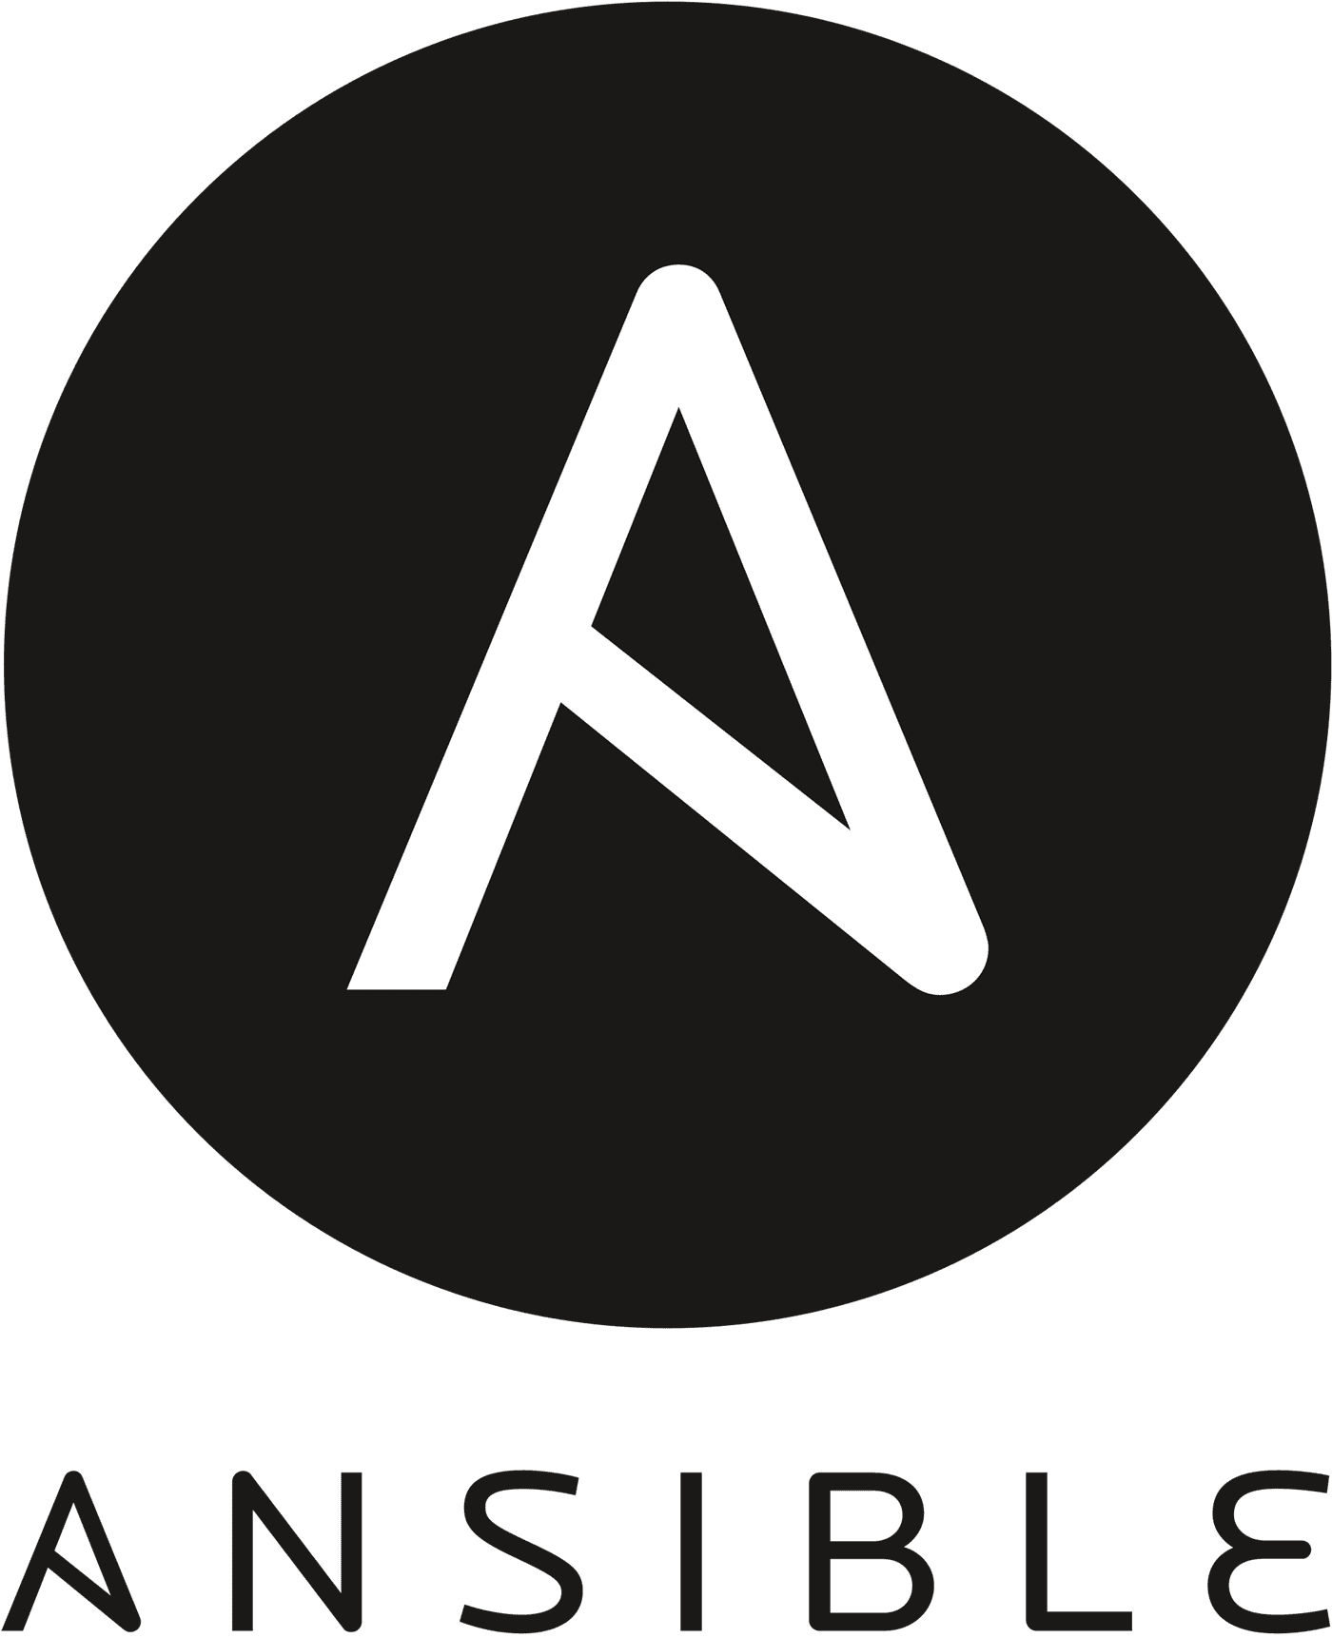
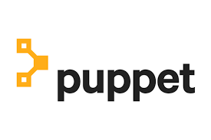
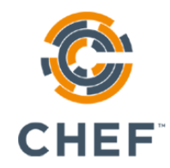
DEVOPS ROAD MAP: CONFIGURATION MANAGEMENT
Centralized configuration file management and deployment
Rolling back to the previous version as the system state is recorded
Chef and Puppet use the pull configuration
Ansible is a push-based tool - it is agentless
SaltStack is also a push-based tool but requires an agent to be installed on the nodes
Pull is where slaves pull code from the master, and Push is the opposite of this

Slide 90
DEVOPS ROAD MAP: CONFIGURATION MANAGEMENT
Configuration planning and management
Configuration identification
Configuration change management
Configuration status accounting
Configuration verification

Slide 91
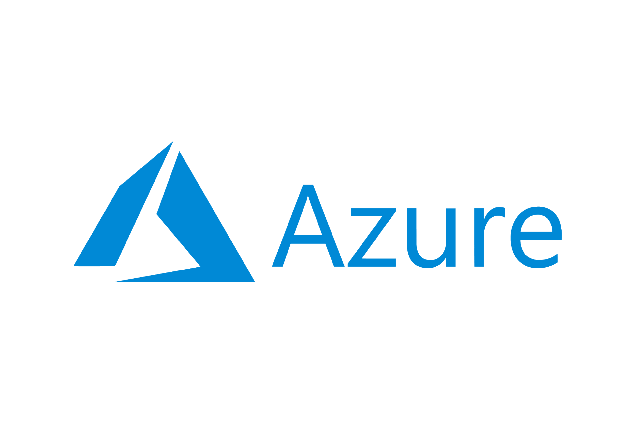

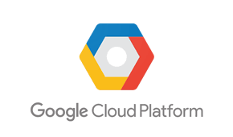
DEVOPS ROAD MAP: INFRASTRUCTURE AS A CODE
“
Cloud Hosting
Cloud computing is the on-demand availability of computer system resources, especially data storage and computing power, without direct active management by the user. The term is generally used to describe data centers available to many users over the internet
“
-Wikipedia
Scalability
Best Performance
Security and Disaster Recovery
Latest Technology
Affordability

Slide 92

AWS HISTORY
2002
The AWS platform launched
2003
New concept and plan formulated
2004
First AWS service (SQS) launched
2006
R-launch with Amazon EC2 instance
2009
Virtual private cloud rollout
2018
Contract with the Pentagon
2017
AWS reaches 100 services in total
2016
AWS hits $10 billion in revenue
2013
The CIA adopts AWS as the provider
2012
First AWS customer event

Slide 93

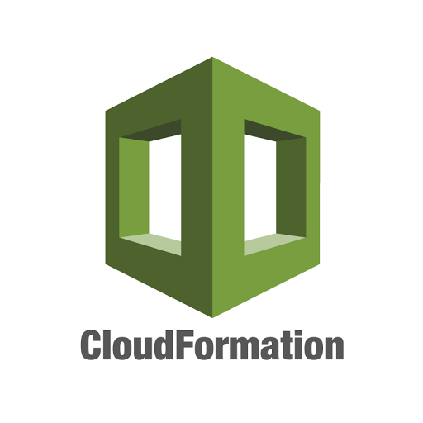
DEVOPS ROAD MAP: INFRASTRUCTURE AS A CODE
Cloud and Infrastructure Provisioning Tools
Provisions servers using scripts and is easy to migrate
The same script provisions 100 servers, which provides sense of consistency
Declarative YAML files

Slide 94
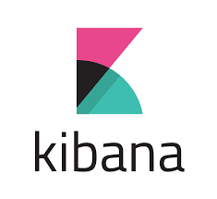
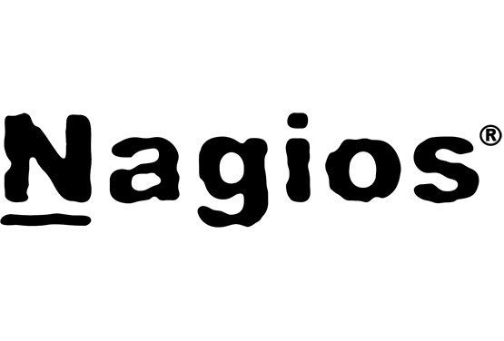

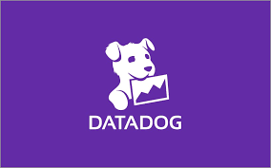

DEVOPS ROAD MAP: CONTINUOUS MONITORING
Monitoring is usually an underrated but a crucial aspect of application availability and the development process
Application Performance Monitoring: It monitors the latency, request per minute, CPU usage, etc. on your application with tools such as Relic
Logging of information such as the source site and the IP are logged for every request
ELK stack: Elasticsearch, Logstash, Kibana
EFk stack: Elasticsearch, Fluentd, Kibana
Metric Monitoring:
Prometheus and InfluxDB: Time series database
Grafana: Visualization
Splunk and Datadog

Slide 95
DEVOPS ROAD MAP: CONTINUOUS MONITORING
Metric Monitoring
Log Monitoring
Numeric-based
Text-based
Easy aggregation, no shaping
Requires shaping before processing
Inexpensive to store owing to high compression
Costly to store and process owing to low compression
Proactive
Reactive
Anomaly detection
Forensic analysis

Slide 96
DEVOPS: ROLES AND RESPONSIBILITIES
01
Responsible for end-to-end reliability and the up time of application
02
Modernise the infrastructure from the monolithic layer to microservices
05
06
Ensure high availability and scalability using cloud automation
03
04
Infrastructure restructuring and server-less technologies
07

Slide 97
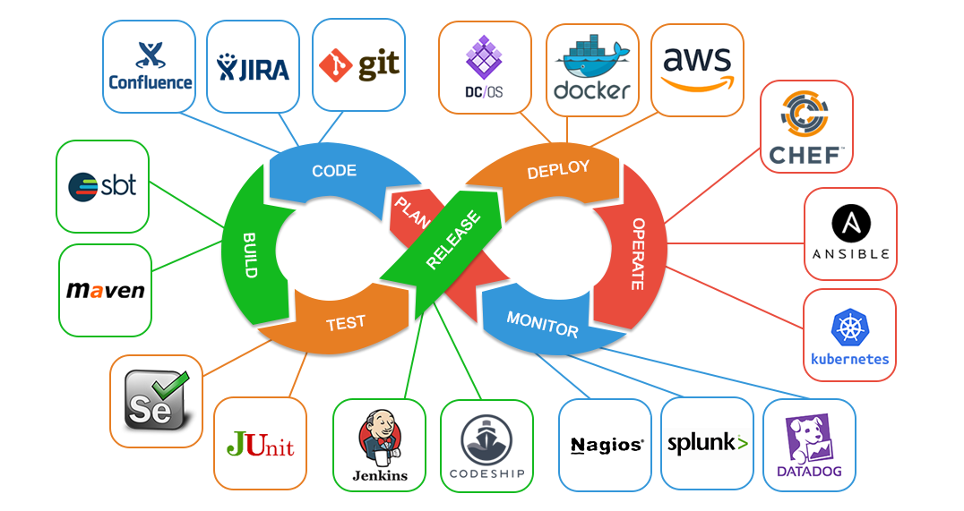
SESSION SUMMARY: DEVOPS ROAD MAP
01
Linux and networking
02
Version control system
03
CI/CD Pipeline
04
Containerization and Cloud
05
IaaC and continuous monitoring
06
DevOps: roles and responsibilities

Slide 98
Poll 6 (15 seconds)
Which of the following terms explains the following statement?
The developer commits changes in code, and it triggers an automatic build, which is compiled, tested, and packaged in artifacts
Continuous integration
Continuous deployment
Continuous delivery
None of the Above
Practice in teams of 4 students
Industry expert mentoring to learn better
Get personalised feedback for improvements
98

Slide 99
Poll 6 (15 seconds)
Which of the following terms explains the following statement?
The developer commits changes in code, and it triggers an automatic build, which is compiled, tested, and packaged in artifacts
Continuous integration
Continuous deployment
Continuous delivery
None of the above
Practice in teams of 4 students
Industry expert mentoring to learn better
Get personalised feedback for improvements
99

Slide 100
MODULE SUMMARY:
INTRODUCTION TO DEVOPS
Minimum viable product and SDLC
Common deployment problems
Concept of DevOps and its principles
Continuous integration and deployment
DevOps road map
DevOps: Roles and responsibilities

Slide 101
Doubt Clearance Window

Slide 102
Tasks to Complete After Today’s Session
MCQs
Conceptual Questions
Project Checkpoint

Slide 103
Thank You!

